Slide 1
DevSecOps: Secure Cloud Enclaves
Sprint 2: Feb 21 - Mar 07
Ethan McIlhenny, Avantika Dasgupta, Josh Manning, Dharmit Dalvi

Slide 2
What are we doing (MVP)?
Creating secure object storage
Disable Public Read/Write
Only allow SSL Requests
Object Versioning
Extensive Logging
Object level logging within buckets
Server access logging to see requests made to a bucket
Traffic and management events in the cloudspace
Enable Log file validation
Rotating Accounts and Credentials from the CONS3RT interface
AUTOMATED

Slide 3
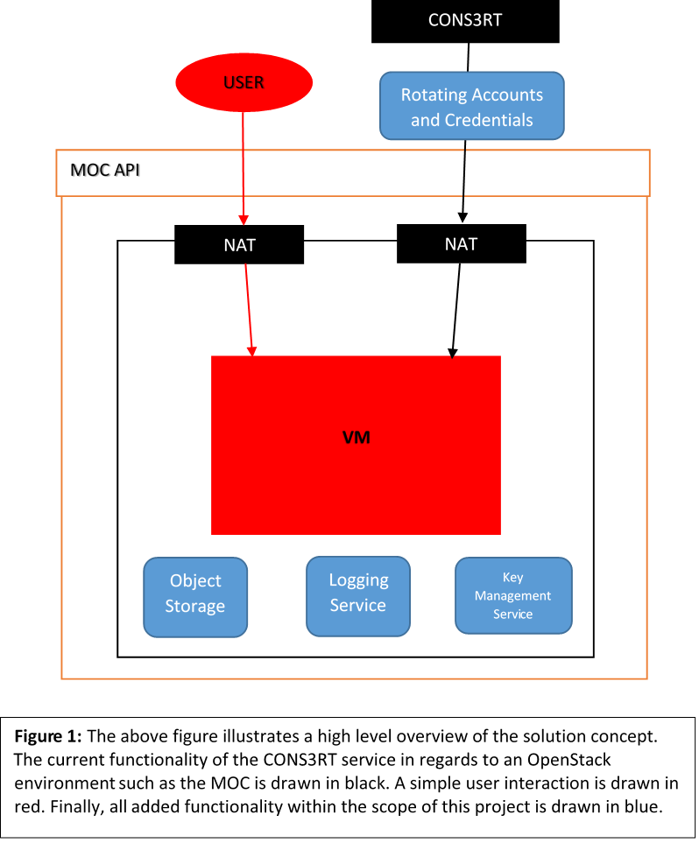
How we are doing it?
CONS3RT creates a “cloudspace” within the MOC environment
NAT gateways
Firewall
Routing
THEY are the only admins
Allows them to design the environment in such a way that all of this logging can be performed
We will be standing up these services within their framework

Slide 4
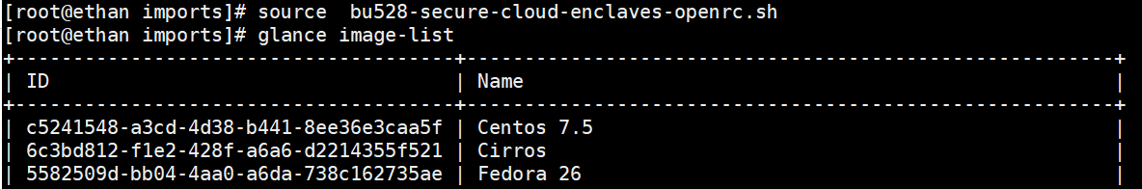
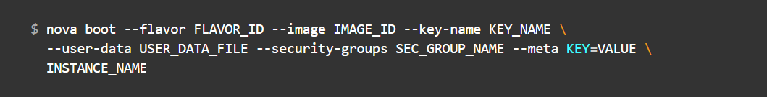
OpenStack Nova Client
API to access images and instances in OpenStack
Connected to MOC Account
Notes:
Create instance of openstack

Slide 5
Creating Object Storage
Using Python Boto to attempt to create buckets on Amazon AWS
SUCCESS!
Transition script to work with the MOC using EC2 Credentials provided in OpenStack
Blocked by Keystone authentication on MOC
Transitioned to using Swift API

Slide 6
Secure Object Storage
Only allow SSL Requests
Endpoint of Object Storage API: http://kzn-swift.massopen.cloud/swift/v1
Redirects to an https link → Should already be secure
Disable Public/Read Write // Object Versioning
Both options within the Swift API calls
Once we have a working “Create Bucket” script in the MOC we can toggle on these features
Notes:
Ssl reqs: swift endpt being used goes thru https, so secure
Be able to toggle at the end, no direct config/implementation needed

Slide 7
DEMO

Slide 8
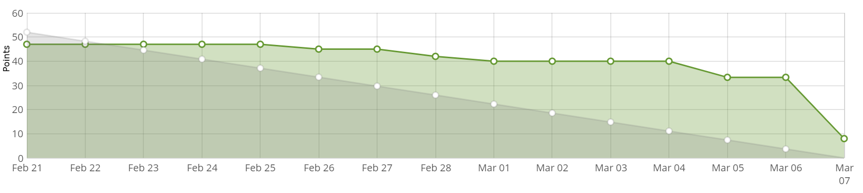
Sprint 2
Completed
Access to the OpenStack Nova API from the command line
Boot an instance from the command window
Create script to make buckets using Python S3 Boto
Challenges
Documentation for Python S3 Boto missing on MOC Website
Using the Object Store API to interact with MOC CEPH

Slide 9
Potential Pivots
The MOC currently supports Kaizen V3, but our client only has v2 enabled
Potential solutions:
Use MOC’s v2 support (outdated)
Have a side project/pivot on updating CONS3RT to support Kaizen 3
We have elected to use MOC’s v2 for now, and have successfully connected to CONS3RT on a local kaizenold account
We will talk to our clients on what (if anything) we may be able to contribute

Slide 10
Future Sprints
Sprint 3: March 7 - March 21
Start Logging
Create dedicated bucket for logs
Enable object level and server access logging
Sprint 4: March 28 - April 11
Finish Logging
Enable validation of log files
Accounts and Credentials
60-Day password rotation
Enforcing password specifications

